Slide 1
Successful SME Participation in FP7-Industrial Perspective
Dr. Mazhar Bari

Slide 2
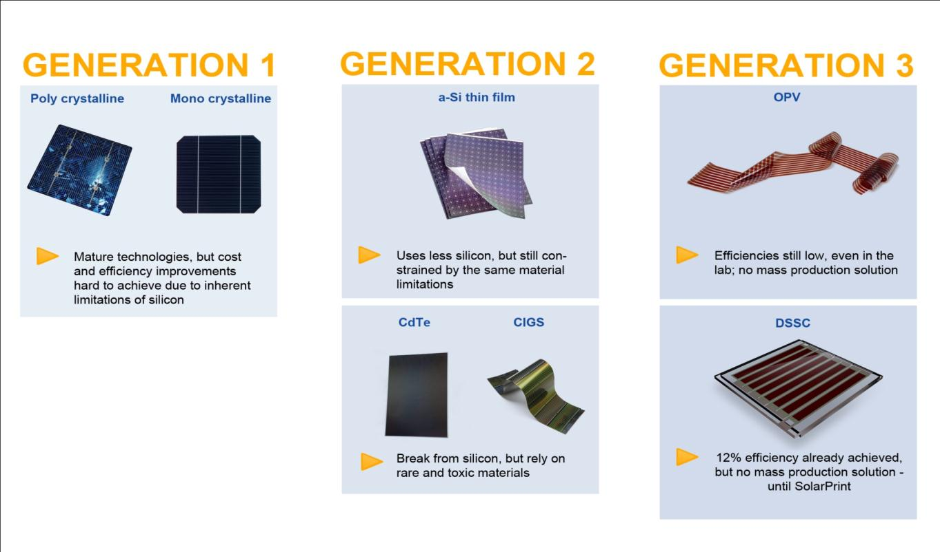
SolarPrint background

Slide 3
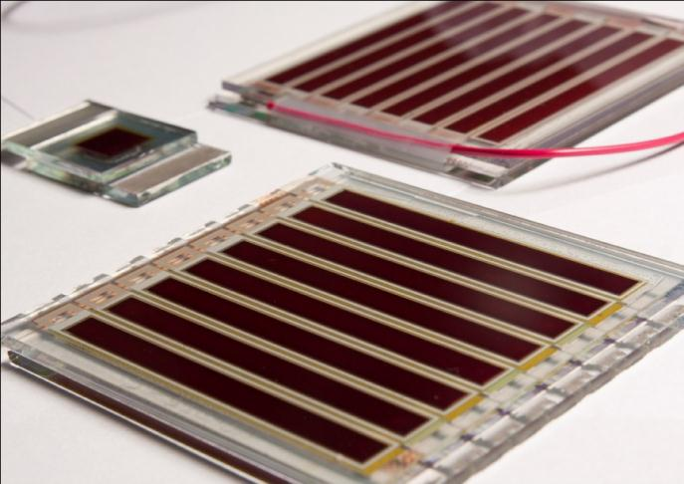
SolarPrint background
SolarPrint provides PV energy harvesting solutions for wireless sensors
SolarPrint is developing the next generation of high-performance indoor solar cells
  DSSC has highest potential for light conversion per unit area (power density)

Slide 4
SolarPrint technology roadmap

Slide 5




Current FP7 active projects
SMARTOP (3 yrs started Jan 2011)
Sust Surface Transport (SST)
Autonomous smart roof integrating solar cells (PV), energy storage systems and auxiliaries for FIAT Cars
CR-FIAT – Webasto – Adetel – Infineon – TCD – UCD – ICL
MOLESOL (3 yrs started Oct 2010)
Future Emerging Tech for Energy Applications (FET)
Carbon-based molecular wiring for Solar Cells
IMEC – Dyesol – Max-Planck Institute
ERG (3 yrs started March 2011)
ENIAC Joint Undertaking
Energy for a Green Society – Sustainable harvesting to smart distribution
STMicroelectronics – AMAT – LEITAT – Telefunken semiconductor – TNI

Slide 6
SolarPrint technology roadmap
MOLESOL
SMARTOP
ERG

Slide 7
Current FP7 proposal activity
Entered 5 proposals in Dec 2012. 2 refused.
NMP:
2 projects at 2nd stage evaluation
R4 SME:
1 project at negotiation stage (ADIOS-Ru) – coordinator role

Slide 8
Experience
Pros
Funding to achieve R&D roadmap – if the projects are well aligned
Technical Network - Access to world class RTD Partners
Commercial Network - Access to co-development & marketing partners, potential customers
3rd party validation of technology & standards development
Enhanced reputation by association with big players
Gain IP
Cons
Tenders & bids are resource-heavy
We have not won all our bids
There is admin involved in participation
FP7 projects move at their own pace
Give / share IP

Slide 9
Experience
Bidding
Pick your partners wisely (back a winning horse)
Big consortia start to form before the calls are released
Don’t spread yourself too thin on multiple bids
Take time to understand the calls & evaluation criteria
Ask for help – EI, your contacts, training
Get the IP right – www.ipr-helpdesk.org
Participating
Get on the right work-packages – technical and partnering
Don’t commit to the impossible
Understand the administrative aspects
Keep the researchers happy
Don’t forget the agreed objectives

Slide 10



www.solarprint.ie
rtwohig@solarprint.ie

